Slide 1
Atomic Structure
PC2232 Lecture 13
Hydrogen Atom

Slide 2
Introductory Remarks
We have earlier used the Bohr model to calculate the energy levels of the hydrogen atom.
We will now attempt to use the Schrodinger equation to get the solutions for these energy levels.
Only important steps and conclusions will be shown.
Schrodinger equation provides a lot more results and insights into the hydrogen atom than the Bohr model and also allows us to go beyond the hydrogen atom.
There are other aspects of quantum mechanics that are generally not dealt with by the Schrodinger Equation – e.g., the electron spin – very important for our complete understanding of the hydrogen atom – which we will deal with in the next lecture.

Slide 3
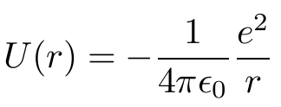
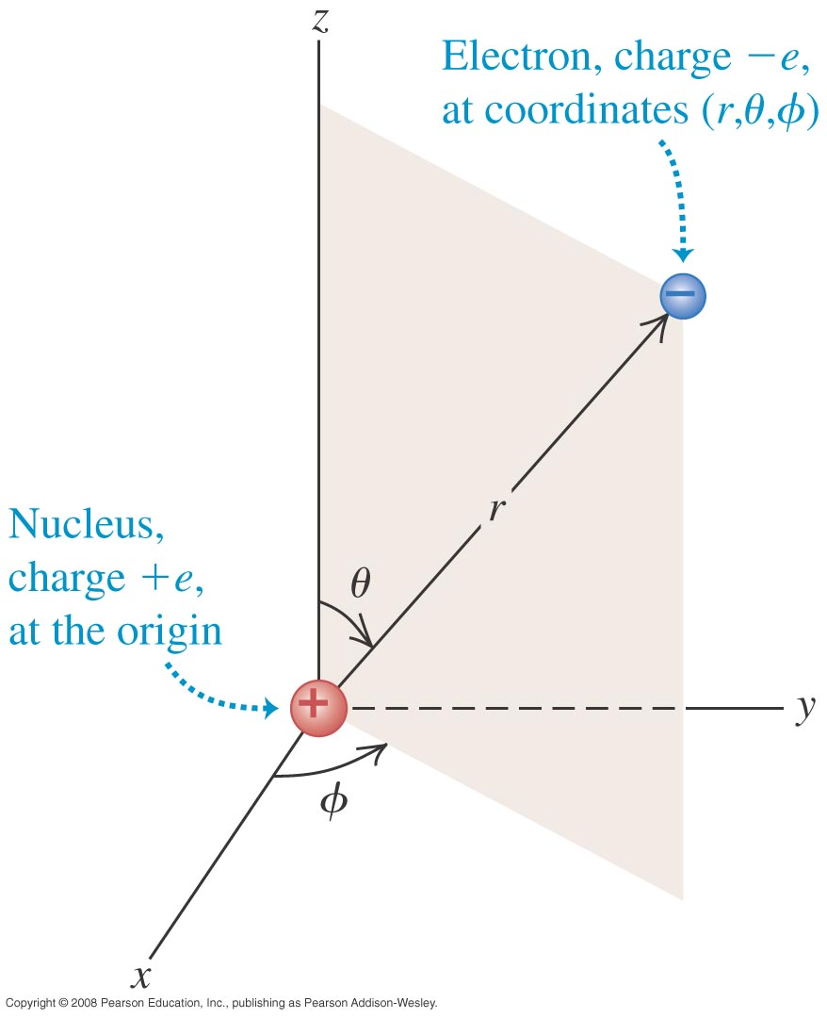
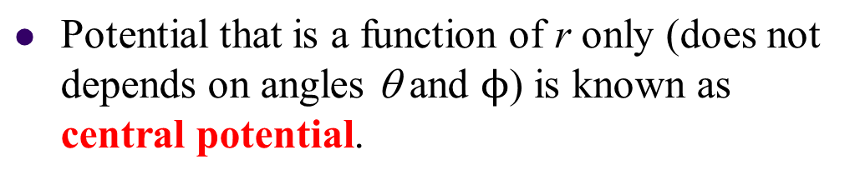
Hydrogen and Central Potential
Hydrogen consists of a proton and an electron. The potential is given by:
The force acting on a particle due to any central potential is always directed towards or away from the origin.
For such potential, classical mechanics has shown that the angular momentum is always conserved.

Slide 4
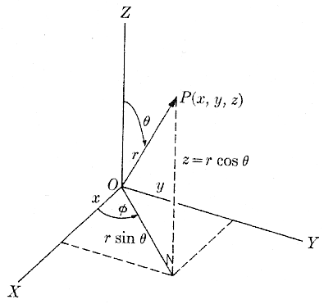
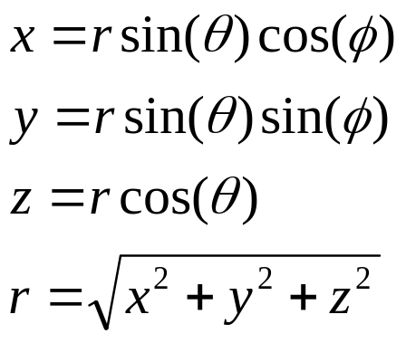
Spherical Polar Coordinates
For hydrogen atom, it is more convenient to work in spherical polar coordinate system where:

Slide 5
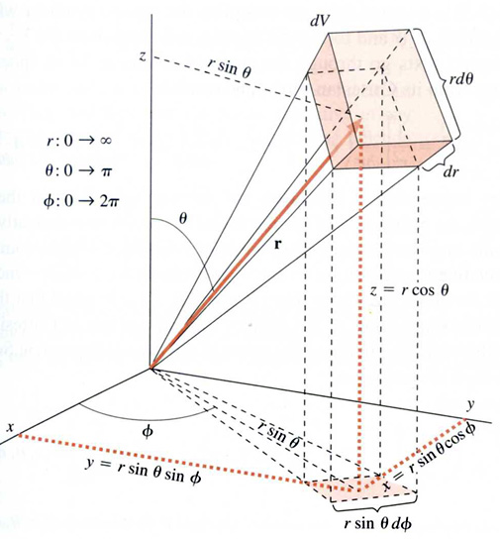

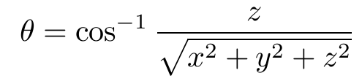


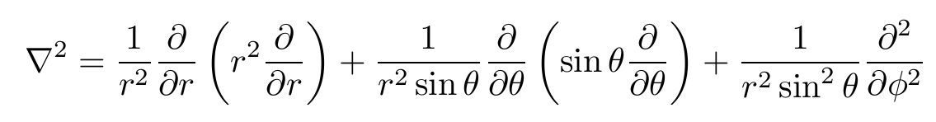
Spherical Polar Coordinates
For hydrogen atom, it is more convenient to work in spherical polar coordinate system where:
And the volume element is:
Lastly, the Laplacian is given by:

Slide 6
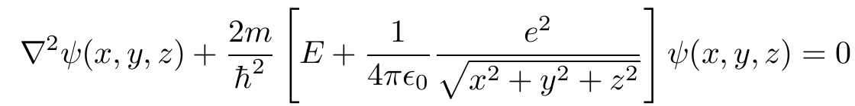
Schrodinger Equation for Hydrogen
As in previous lecture, the Schrodinger Equation in 3-D is
OR
It is nearly impossible (?) to solve the above in Cartesian coordinates. Instead one should make use of the fact that U is only a function of r by working in the polar coordinates.
Inserting the Laplacian in polar coordinates in the equation gives:
(This equation looks complicated but it allows us to find the solutions!)

Slide 7

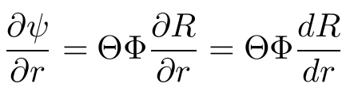
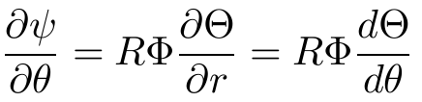
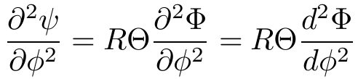
Schrodinger Equation for Hydrogen
With the Coulomb potential for U(r) and multiplying by r² sin²θ:
Writing the SE in spherical coordinates allow us to separate it into three independent equations, each involving only one variable.
We write the solution as a product of three different functions:
We see that:
Substitute into the Schrodinger Equation above and divide by RΘΦ:

Slide 8
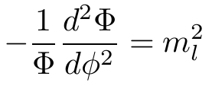
Schrodinger Equation for Hydrogen
LHS is a function of only θ and r while the RHS is a function of φ only! This can only be correct if both sides are equal to some constant. It is convenient to call this constant m_{l}², so that:
Substitute the above in the Schrodinger Equation, divide by sin²θ, and rearranging:

Slide 9
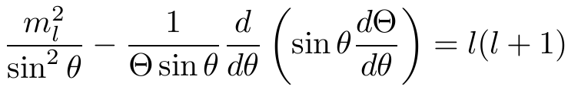
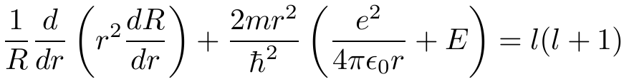
Schrodinger Equation for Hydrogen
Substituting m_{l}², dividing by sin²θ and rearranging
Again LHS is a function of r only while the RHS is a function of θ only and thus both sides must be equal to some constant. For reason apparent later, let us call this constant l(l+1), so that:

Slide 10
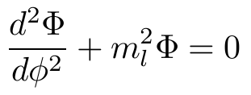
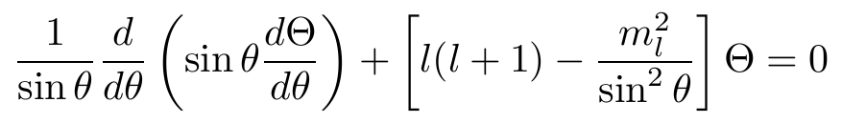
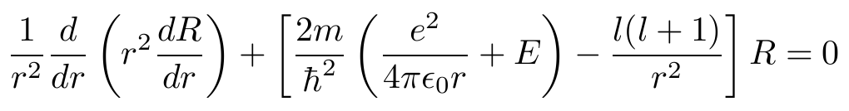
Schrodinger Equation for Hydrogen
Thus we have simplified the Schrodinger Equation for hydrogen atom from a partial differential equation for a function of three variables into three independent ordinary differential equations, each for a single function of a single variable.

Slide 11





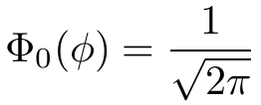
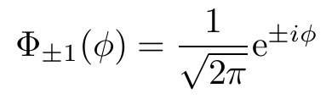
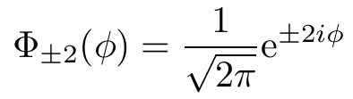
Magnetic Quantum Number
m_{l} is known as the magnetic quantum number.
Below are some of the functions of

Slide 12



Orbital Quantum Number
l is known as the orbital quantum number, as it is related to the “orbital motion” of the electrons.
It can be shown that the above differential equation for Θ(θ) can be solved provided the constant l is an integer equal to or greater than |m_{l}|, the absolute value of m_{l}. Thus:

Slide 13
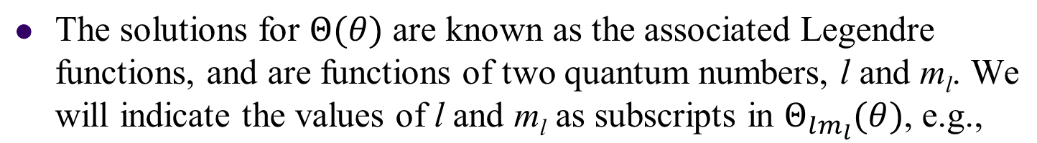

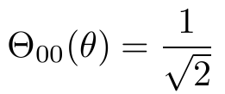
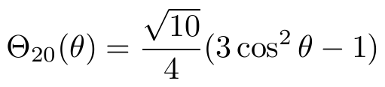
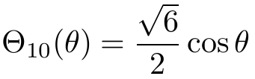

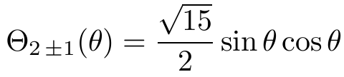

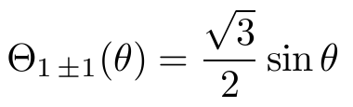
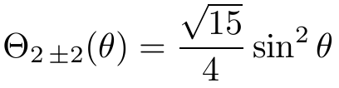
Polar Solutions

Slide 14
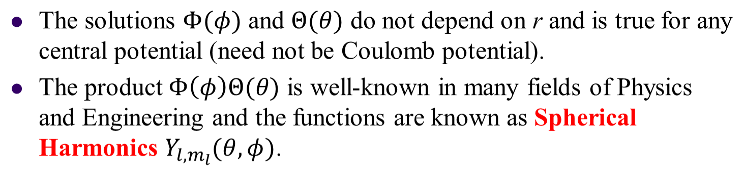
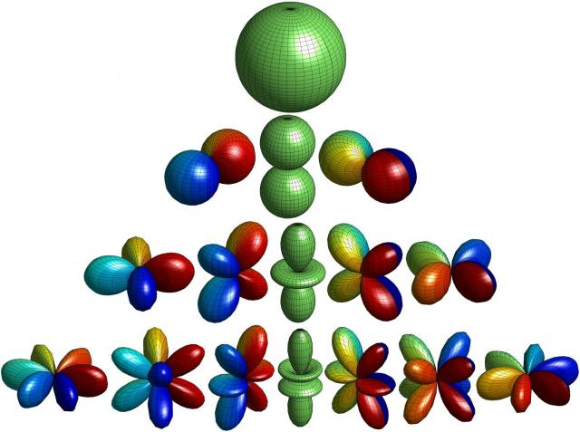
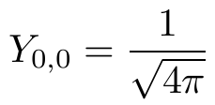
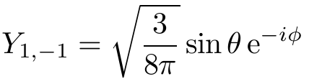
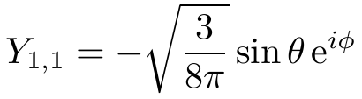
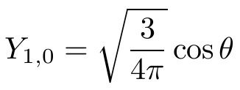
Spherical Harmonics

Slide 15
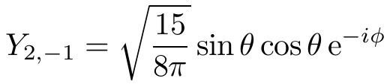
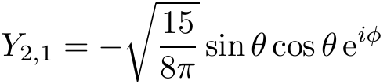
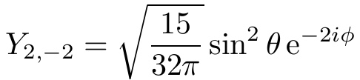
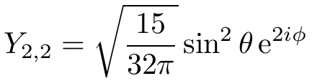
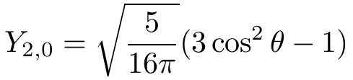







Spherical Harmonics
For l = 2, we have:
For l = 3, we have:

Slide 16
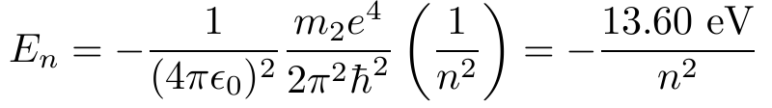

Principal Quantum Numbers
It can be shown that the solutions for the differential equation for R(r) requires that energy of hydrogen atom E be positive or have one of the negative values specified by
where n is an integer. The above results for the energy of hydrogen atom are exactly the same as that obtained by Bohr!
n is known as the principal quantum number. The solution for R(r) also requires that that n be equal to or greater than (l + 1) where l is the orbital quantum number. That is

Slide 17
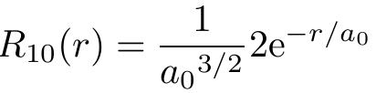
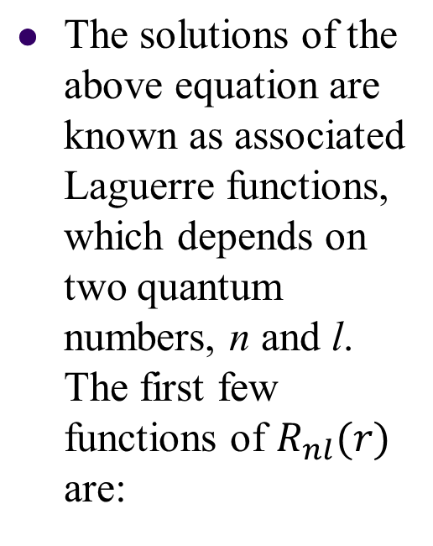
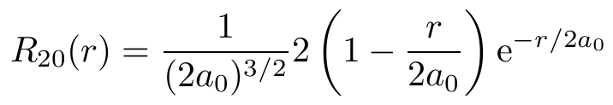
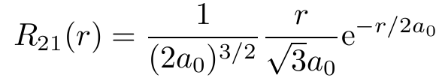
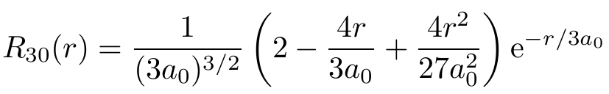
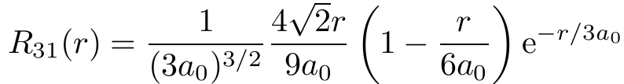
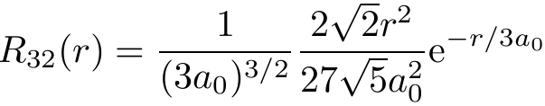
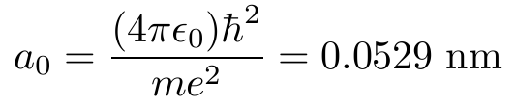
Radial Solutions

Slide 18

Quantum Numbers (Summary)
We see that 3 quantum numbers are required to specify the state of the hydrogen completely (for 3 dimensions). These quantum numbers appear naturally in the quantum-mechanical theories of particles trapped in a particular region in space.
Only certain values and combinations are permissible for these quantum numbers:
principal quantum number
orbital quantum number
magnetic quantum number
Spectroscopic Notation: The states of different values of l are known historically (and still used now) as:
Value of l | 0 | 1 | 2 | 3 | 4 | 5
Letter | s | p | d | f | g | h

Slide 19
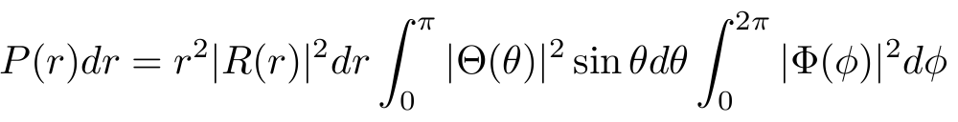

Radial Probability
The probability density of the electron at (r, θ, φ) is proportional to |ψ|² but the actual probability of finding it in infinitesimal volume element dV is |ψ|²dV where we have
We have so far normalized R(r), Θ(θ) and Φ(φ) individually so that the actual numerical probability P(r)dr of finding the electron somewhere between r and r+dr from the nucleus is

Slide 20

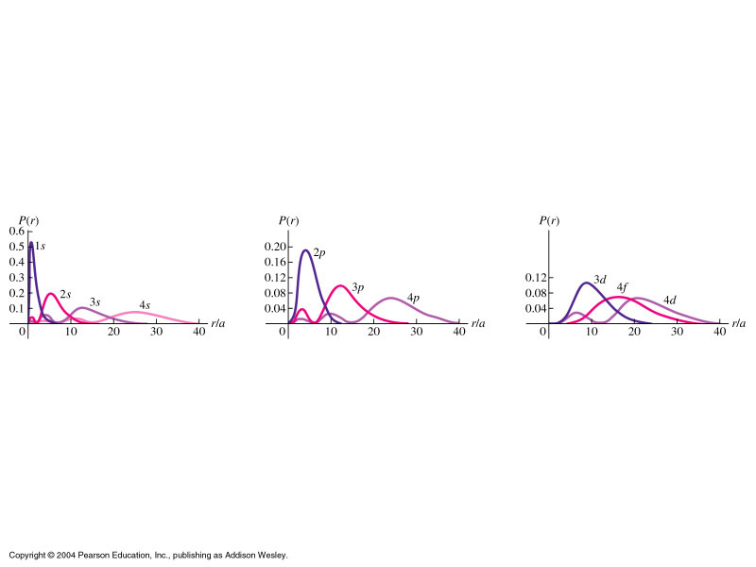





Radial Probability
Note that for the s-states (l = 0), P(r) is maximum at a certain distance from nucleus (whereas R(r) is maximum at nucleus!). In fact P(r) = 0 at nucleus.
We can see that (proved in tutorial) P(r) is maximum at a₀ for 1s state, 4a₀ for 2p state, 9a₀ for 3d state and 16a₀ for 4f state. These are the radii given by Bohr’s model! (a₀ = Bohr radius). For other states, as n increases, there is higher probability of finding electron further out.
For each l value, the next higher n value will have one extra value of r where P(r) = 0 [node in R(r)].

Slide 21




Electron Probability Density
The s-states is spherically symmetric and does not depend on θ and φ. The probability density |ψ_{n00}|² of these states are just |R_{n0}|²

Slide 22






Wave Functions of Hydrogen Atom

Slide 23






Wave Functions of Hydrogen Atom
For n = 3:

Slide 24
Wave Functions of Hydrogen Atom
For n = 4, the probability densities for various states are as follows:
http://www.falstad.com/qmatom/

Slide 25

Wave Functions of Hydrogen Atom
Compare the states (2,1,1), (3,1,1), (4,1,1) – angular dependence are the same, extra maximum in radial
direction.
http://www.falstad.com/qmatom/

